Slide 1


The Role of African Storytelling in Business and Information Technology
Exploring Cultural Insights for Modern BBIT Practices
by Rochelle Awuor
C027-01-1130/2021

Slide 2
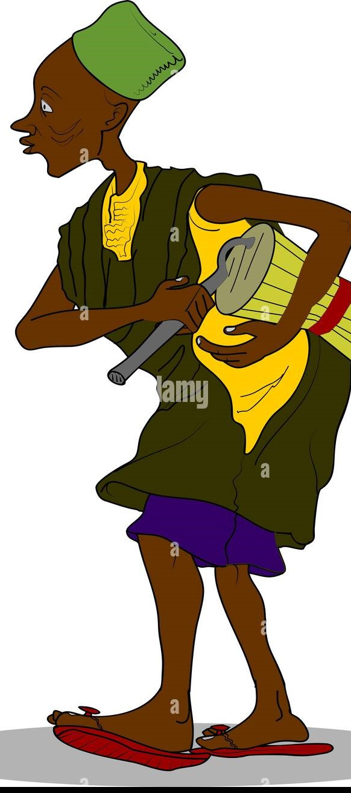

The Legacy of African Storytelling
1.Preserving History:
African storytelling has been a primary method for preserving history in societies where written records were less common. Through oral traditions, historical events, genealogies, and significant cultural milestones have been passed down through generations.
2.Imparting Wisdom:
Storytelling in African cultures goes beyond mere entertainment; it serves as a vehicle for imparting wisdom and moral lessons. Through folktales, proverbs, and parables, storytellers convey essential values such as honesty, courage, respect, and humility.
3.Cornerstone of African Culture:
African storytelling is more than a tradition; it is the foundation upon which many other cultural practices are built. It is intertwined with music, dance, and rituals, making it a holistic cultural expression. The rhythm of the drums, the chants, and the dances often accompany the stories, creating a rich, multi-sensory experience that is uniquely African.

Slide 3
Relevance to Business and IT
1.Clear Communication:
In the field of Business and Information Technology (BBIT), clear and effective communication is crucial for success. Whether it’s managing a project, leading a team, or developing a user-centered product, the ability to convey ideas clearly can determine the outcome of business endeavors.
2.Ethical Guidance:
In the context of BBIT, the ethical principles drawn from storytelling can guide professionals in making responsible choices, whether it’s about data privacy, cybersecurity, or the impact of technology on society. Stories about integrity, responsibility, and the consequences of unethical actions remind BBIT professionals of the importance of maintaining ethical standards in their work.
3.Collective Knowledge:
African storytelling is inherently a collective practice, where knowledge is shared, preserved, and passed down through generations. This communal approach to knowledge management is mirrored in modern IT practices such as open-source development, collaborative platforms, and knowledge-sharing networks.

Slide 4

The Power of Narrative in Communication
1.Storytelling’s Role in Conveying Complex Ideas Simply:
African storytelling is renowned for its ability to simplify complex concepts through the use of relatable characters, vivid imagery, and moral lessons. By breaking down intricate ideas into a narrative structure, storytelling makes it easier for the audience to grasp the core message and retain the information.
2.Application in Marketing:
African storytelling, with its rich tradition of using metaphor, allegory, and symbolism, offers valuable techniques for marketers looking to create compelling brand narratives. These stories can be used in advertising campaigns, social media content, and customer engagement strategies to differentiate the brand and resonate with the target audience.

Slide 5
Ethical Lessons from African Stories
Stories Teaching Integrity,consequences:
Application in Business Decision-Making:
Many African folktales depict characters who face challenges or temptations, ultimately teaching the importance of honesty and ethical behavior.
African storytelling provides valuable insights into navigating these challenges by emphasizing the importance of ethical decision-making and accountability.
Fostering a Culture of Ethical Awareness:
Application in IT Governance
Integrating ethical lessons from African storytelling into organizational culture fosters an environment where ethical behavior is valued and prioritized.
African storytelling can inform IT governance by emphasizing ethical responsibilities regarding the development and use of technology

Slide 6

Integrating African Storytelling into BBIT
1.Enhancing Leadership Through Storytelling:
Integrating African storytelling into Business and Information Technology (BBIT) can significantly enhance leadership styles and practices. Storytelling serves as a powerful tool for leaders to communicate their vision, values, and goals in a compelling manner.
2.Fostering Innovation:
The integration of African storytelling into BBIT can foster a culture of innovation by encouraging creative thinking and adaptability. Storytelling allows individuals to explore different narratives, challenge assumptions, and envision new possibilities.
3.Culturally Sensitive Solutions:
The principles of African storytelling emphasize the importance of understanding and respecting cultural contexts. By incorporating these principles into BBIT practices, professionals can develop technology solutions that are not only effective but also culturally sensitive and relevant to the communities they serve.

